Slide 1



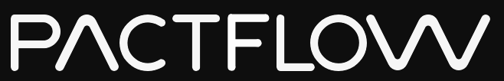

Brought to you by
Notes:
Business impact of integrated tests
Cause / explanation of these effects
Alternative approach (isolation + contracts)
Pact

Slide 2
Brought to you by

Slide 3
VISION
Our vision is to transform the way teams test and release distributed systems.
Integration testing is hard...
Brought to you by

Slide 4




BACKGROUND
The numbers
Four key indicators of high performing organisations¹
Need < 1 day lead time for changes = 106x faster time from commit -> deploy
Are able to deploy on demand = 208x more deployments
Have change failures rates < 15% = 7x lower change failure rates
Can restore services within 1 hour = 2604x faster MTTR
¹ Data from the DORA 2019 State of DevOps report
Brought to you by
Notes:
We know what good looks like. The state of devops
In addition, Automated deployments (to test or prod, including automated environment provisioning) are associated with ~70% of elite performers

Slide 5
BACKGROUND
The numbers
Challenges facing the market
Only 20% of companies are “elite” performers¹
81% of teams spend a third of their time or more on fixing environments²
36% of teams are impacted by wait times and cost of test environments²
76% spent one third of their time or more managing test data²
¹ Data from the DORA 2019 State of DevOps report
² Data from a Capgemini report on continuous testing in March 2019
Brought to you by

Slide 6
ABOUT PACTFLOW
In 2013 we created Pact, an Open Source tool to solve this problem. In 2019, we launched Pactflow to enable organisations to do this at scale
Brought to you by

Slide 7
ABOUT PACTFLOW
Journey
How we got here
Pact created on a client project at realestate.com.au to solve problems testing microservices
Huge growth in popularity and language support (.NET, Go, JS, Python etc.)
🚀 Launch of Pactflow: a commercial project to solve integration testing at scale
2013
2015 - 2016
2019
2014
Dec 2016 - 2018
2020+
Pact Open Sourced (Ruby, JVM), initial adoption. Microservices becomes “a thing”
MVP: Launch of the “Hosted Pact Broker” - an early MVP of Pactflow. ~1000 signups
Goal: Sustainable business
>1500 customers
Solving bigger problems
In Product + OSS

Slide 8










HOW WE TEST MICROSERVICES NOW
The old way...
Why this is hard
Slow
Fragile
Test data management
Test environment management
Coverage?
All-at-once painful deployments
Teams wait on build queues
JSON/HTTP
JSON/HTTP
API Gateway
JSON/HTTP
JSON/HTTP
Microservice A
Microservice B
JSON/HTTP
#1
#2
#3
#4
#5
JSON/HTTP
JSON/XML
Microservice C
MQ

Slide 9
HOW WE TEST MICROSERVICES NOW
Scaling
Developer idle time (queues)
Build time
Risk associated with change
Cost / Complexity / Time
# Environments
Teams + Components
Linear increase in teams and components results in exponential increase in other factors
Number teams / components
Notes:
We find that we have Cohesive services, loosely coupled (want) but have cohesive teams, tightly coupled by services (got)

Slide 10
HOW WE TEST MICROSERVICES NOW
Where do we go wrong?
Brought to you by

Slide 11
HOW WE TEST MICROSERVICES NOW
Where we went wrong
Cause and effect
Release coupling
Environment management vs developer idle time
Slower pipeline leading to batching
Batching increases failure and defect rates
Increased Integration tests failures
Increased deployment risk
Separate testing teams introduced
“Release Manager” introduced to govern the entire release process
Tech debt accumulation
We used the same tools and approaches that worked for monoliths and applied it to distributed systems
Brought to you by
Notes:
Our teams were able to build independently, but were forced to collaborate closely in order to ship;
We had to manage and pay for an exponential amount of environments, or wear the cost of additional developer idle time;
Our delivery pipeline has grown linearly in time resulting in batching changes together;
Batching has resulted in increased failure and defect rates;
Integration tests failure results in disproportionately more time debugging them;
Deployments are riskier than when we were continuously shipping the original monolith;
The role of “Tester” emerged, whose job was to manually test features in fixed environments and fix build issues instead of coaching and doing exploratory testing;
The role of “Release Manager” emerged, to govern the entire release process;
Tech debt has accumulated as a result of these pressures.
We used the same tools and approaches that worked for monoliths and applied it to our new world

Slide 12
HOW WE TEST MICROSERVICES NOW
“Integration tests are a scam”
JB Rainsberger
Notes:
Any test where its success/failure depends on many different bits of interesting behaviour at once

Slide 13
HOW WE TEST MICROSERVICES NOW
Scam, you say? Justify!
Integrated tests are:
Slow
Fragile
Hard to manage
When they fail, you can’t point to the problem!

Slide 14
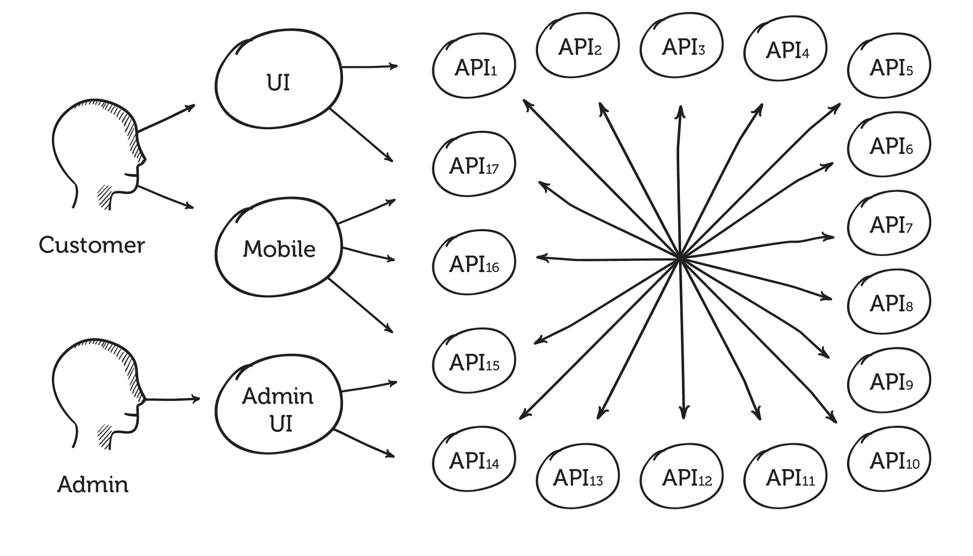
HOW WE TEST MICROSERVICES NOW
Notes:
How can we get 100% coverage here?
Consumer -> Provider 3 integration tests actually cover 7 boxes.
Let’s assume Downstream 1+2 are terminating cases.
Code path complexity is combinatorial:
Assuming only 2 branches in each box ~ 128
Assuming only 5 branches in each box ~78,125
Assuming 10 branches in each box ~10M
If we add another component with 10 branches we get 100M!

Slide 15
HOW WE TEST MICROSERVICES NOW
Branches per box vs test cases required
2 code branches = 128 tests
5 code branches = 78,125 tests
10 code branches = 10M tests

Slide 16
HOW WE TEST MICROSERVICES NOW
Notes:
Actual architecture for a institution in the financial Melbourne

Slide 17
A BETTER WAY TO TEST MICROSERVICES
Good tests have the exact opposite properties
Notes:
Speed
Isolation
Simplicity
But how can we do this across service boundaries???

Slide 18
A BETTER WAY TO TEST MICROSERVICES
Mocks to the rescue?
Notes:
Speed
Isolation
Simplicity
But how can we do this across service boundaries???

Slide 19
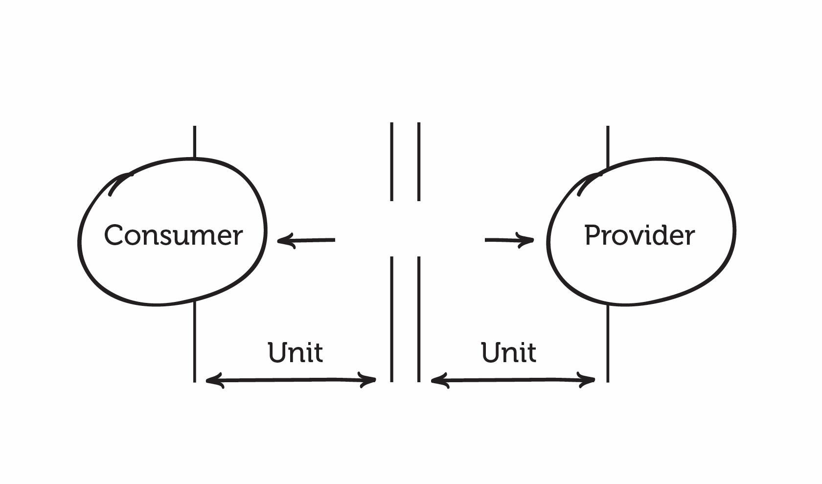
A BETTER WAY TO TEST MICROSERVICES

Slide 20

A BETTER WAY TO TEST MICROSERVICES

Slide 21
A BETTER WAY TO TEST MICROSERVICES
Mocks
Solved problems
New problems
Fast feedback
Few dependencies
No dedicated environment
Reliable
Easy to debug
Hard to keep both sides in sync
‹#›

Slide 22

A BETTER WAY TO TEST MICROSERVICES
Dictator Driven Contracts
Notes:
OK, so we’ve established that integrated tests are bad and we want isolation.
Perhaps documenting APIs and properly versioning them will be better??

Slide 23
A BETTER WAY TO TEST MICROSERVICES
How to: dictator driven contracts
Sit in ivory tower and postulate
Document perfect API (Swagger/OAS etc.)
Create said API
Publish said document to consumers
Repeat steps 1-4
Notes:
Speed
Isolation
Simplicity
But how can we do this across service boundaries???

Slide 24
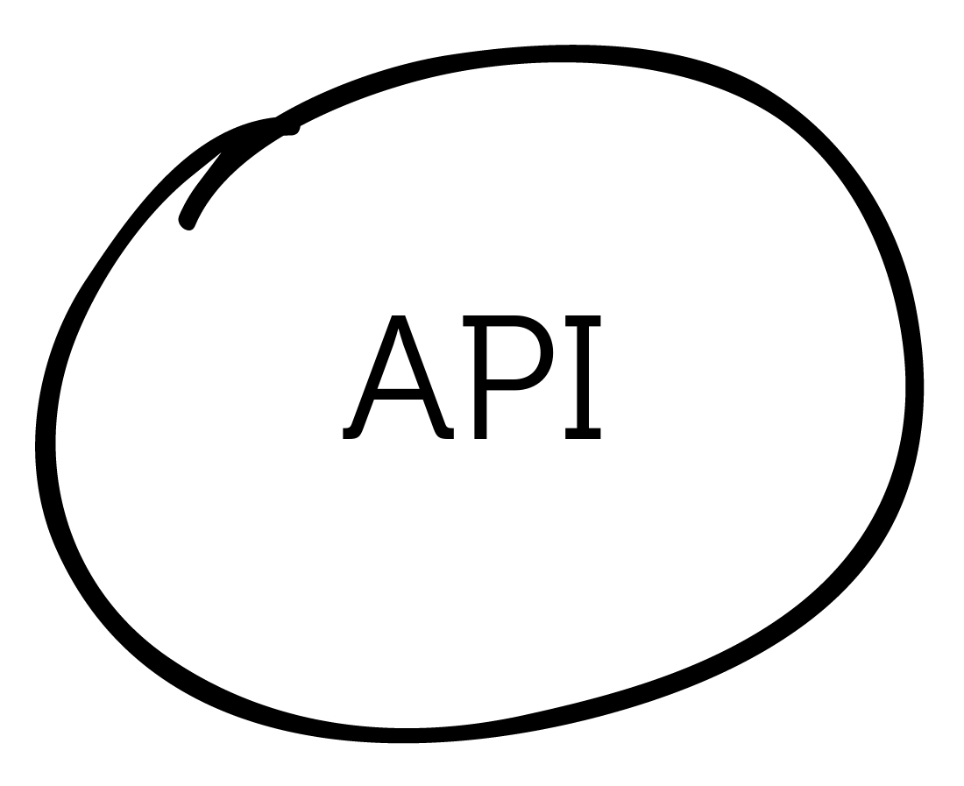
A BETTER WAY TO TEST MICROSERVICES

Slide 25
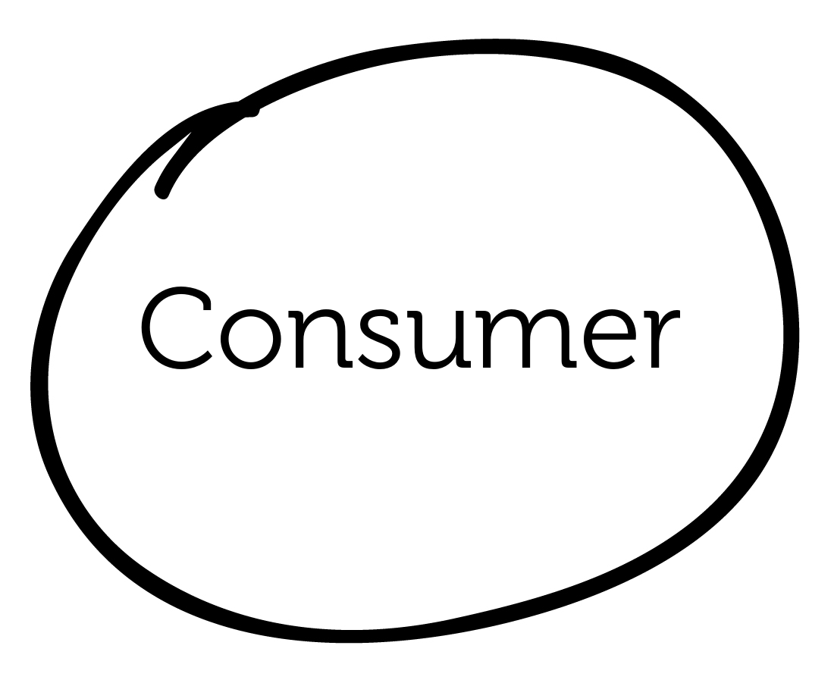

A BETTER WAY TO TEST MICROSERVICES

Slide 26
A BETTER WAY TO TEST MICROSERVICES

Slide 27
A BETTER WAY TO TEST MICROSERVICES
Specification first design
Solved problems
New problems
Good documentation
Aides discoverability and communication between teams/organisations
Clearer expectations on API
Who is using my API?
Requires diligence to ensure backwards compatibility
Developers hate versioning
Limited by expressiveness of specification (vague)
= Hard to get 100% coverage
Notes:
Speed
Isolation
Simplicity
But how can we do this across service boundaries???

Slide 28
A BETTER WAY TO TEST MICROSERVICES
Dictator Consumer Driven Contracts

Slide 29

A BETTER WAY TO TEST MICROSERVICES

Slide 30
A BETTER WAY TO TEST MICROSERVICES
Consumer Driven Contracts
Benefits
You know when you break a consumer
You get a form of documentation
You can test things independently
Notes:
Speed
Isolation
Simplicity
But how can we do this across service boundaries???

Slide 31
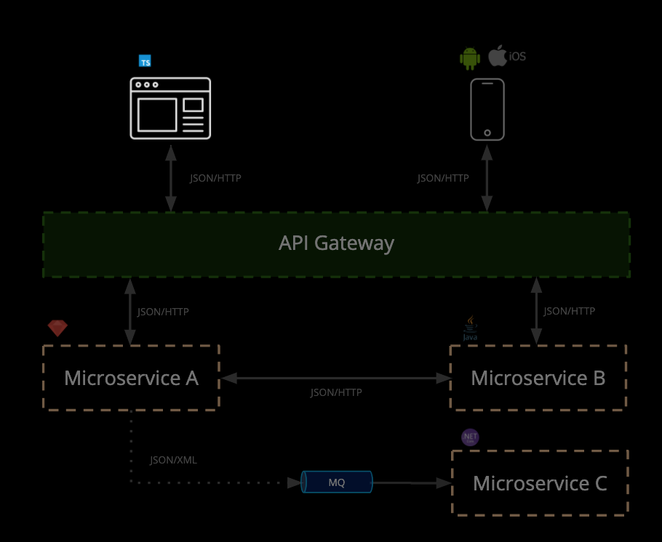
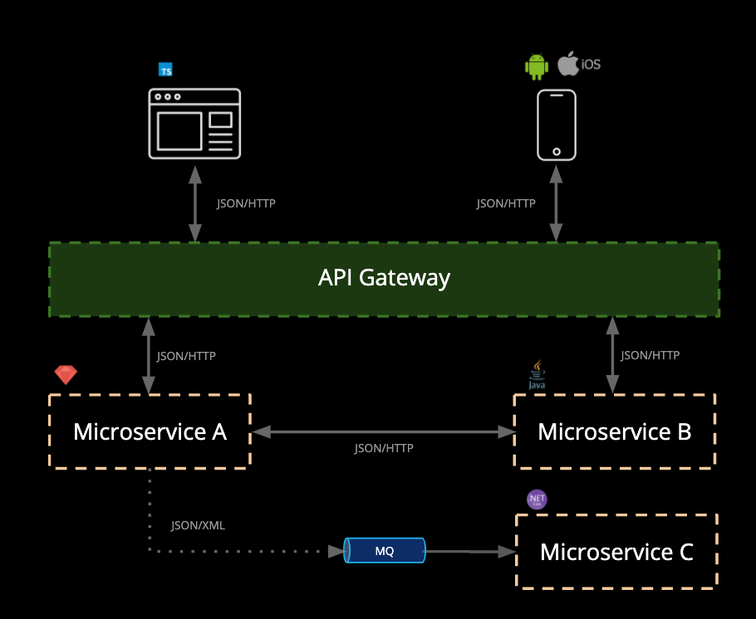
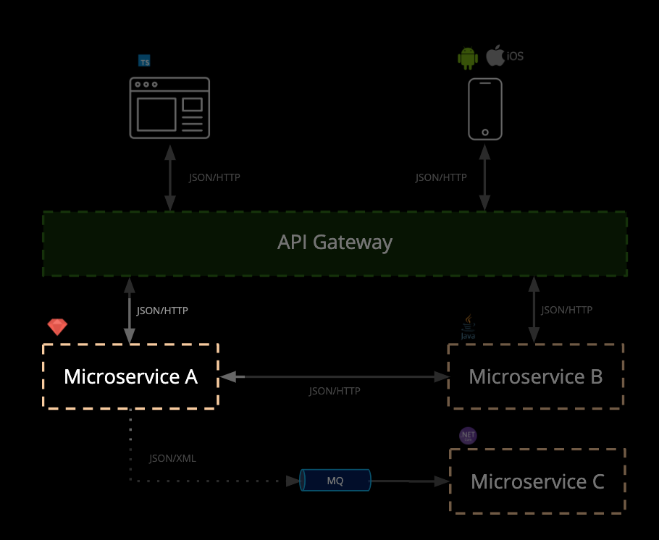
HOW IT SHOULD BE DONE
What is Pact?
Microservice testing made easy
Benefits:
Focus on testing a single integration at a time - without having to deploy
No dedicated test environments
Get fast, reliable feedback
Tests that scale linearly
Deploy services independently

Slide 32
PRODUCT
What is Pact?
Microservice testing made easy
Pact is an Open Source tool that makes it easy to test microservices quickly, independently and release safely.
Pact is already used by thousands of companies worldwide.
Use cases:
Javascript web applications (e.g. React)
Native mobile applications
RESTful microservices with JSON and XML
Asynchronous messaging (e.g. MQ)
Removing end-to-end integrated tests
Reducing reliance on complex test environments
JSON/HTTP
JSON/HTTP
API Gateway
JSON/HTTP
JSON/HTTP
Microservice A
Microservice B
JSON/HTTP
JSON/XML
Microservice C
MQ

Slide 33


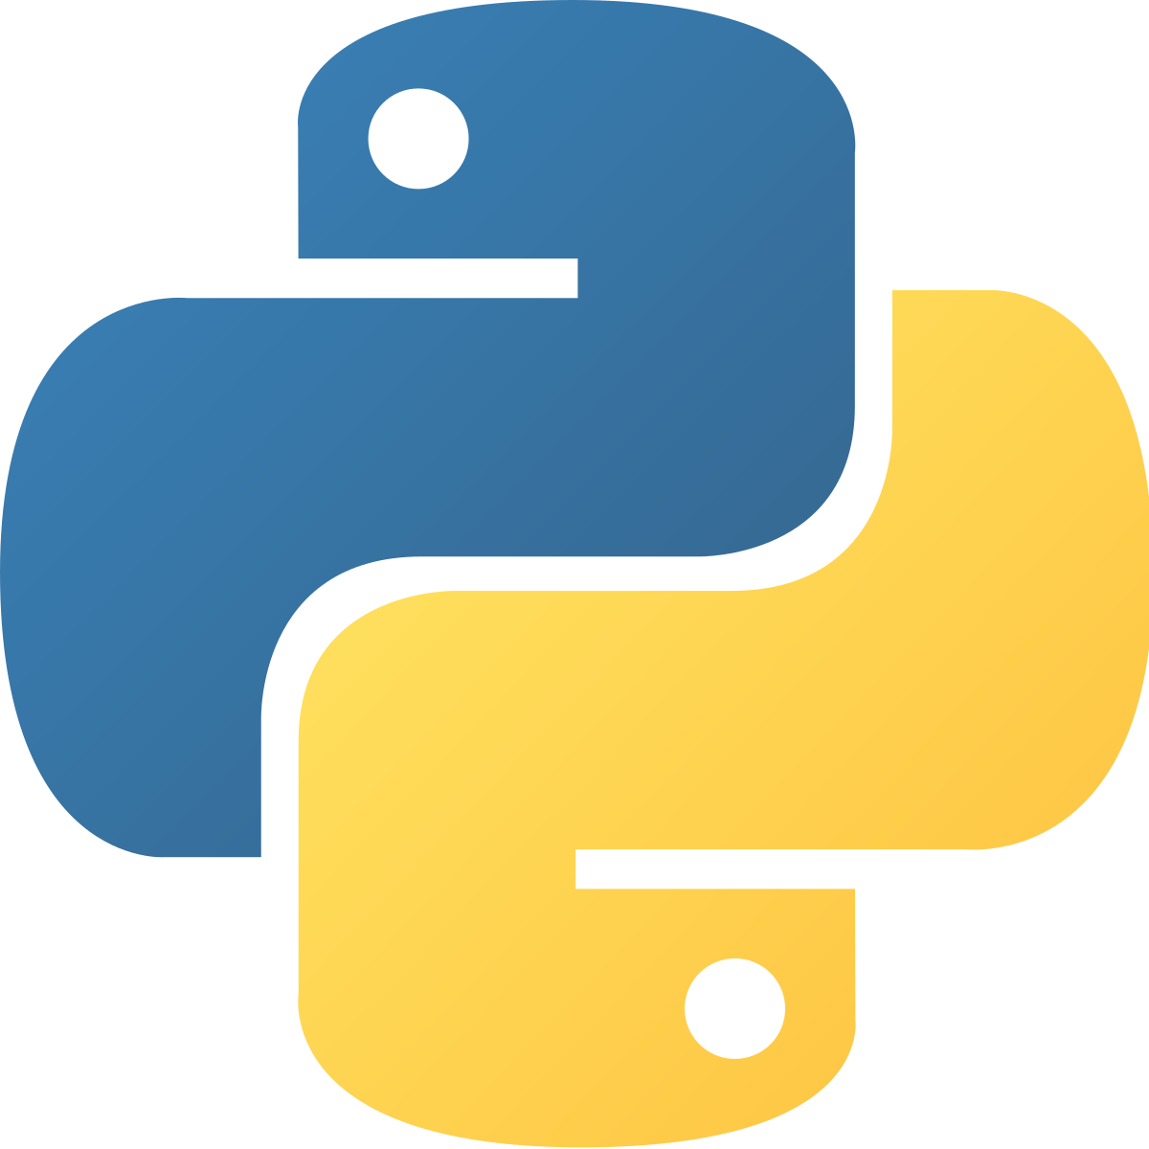

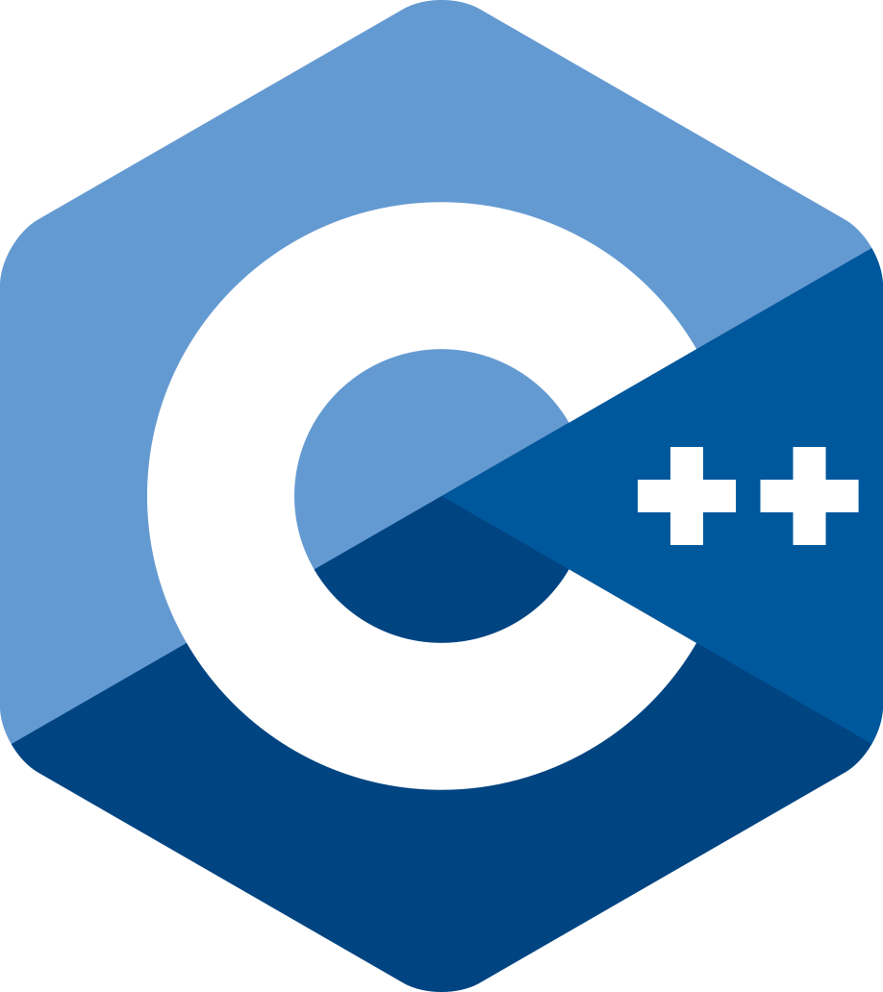



PRODUCT
Open Source
...and in your preferred language
Brought to you by

Slide 34
DEMO
HOW PACT WORKS
Brought to you by

Slide 35


PRODUCT
Consumer
Contract
GET /orders/1234
{
“id”: 1234,
“items”:[
...
],
}
Order API
Provider
Notes:
Let’s get our vocabulary clear

Slide 36

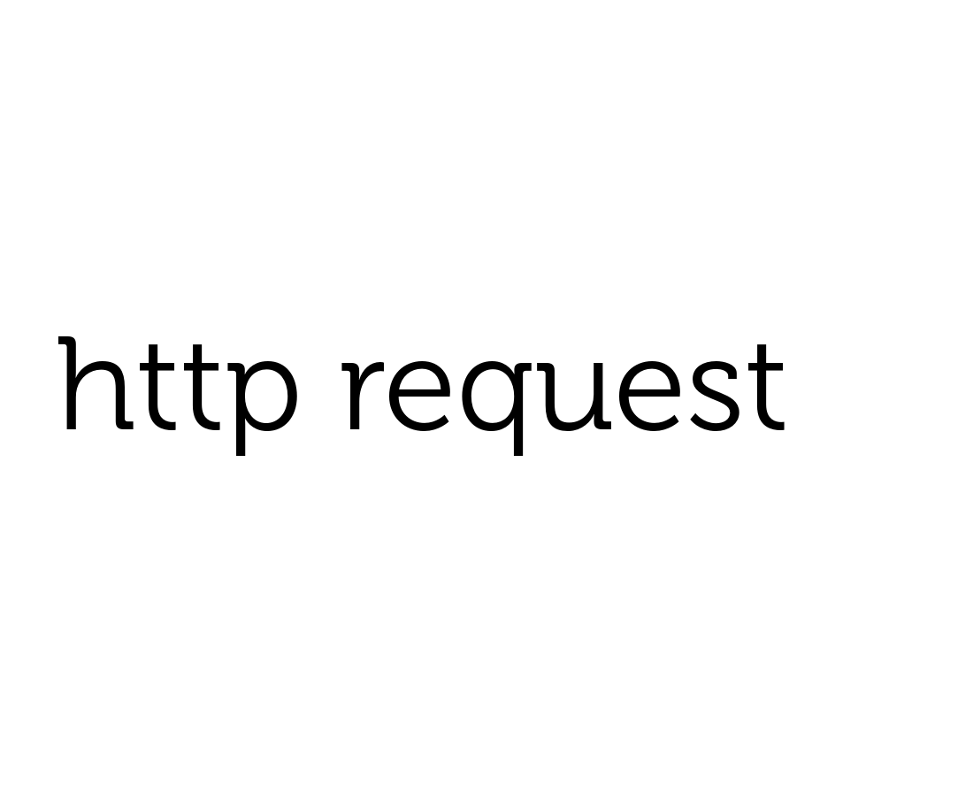
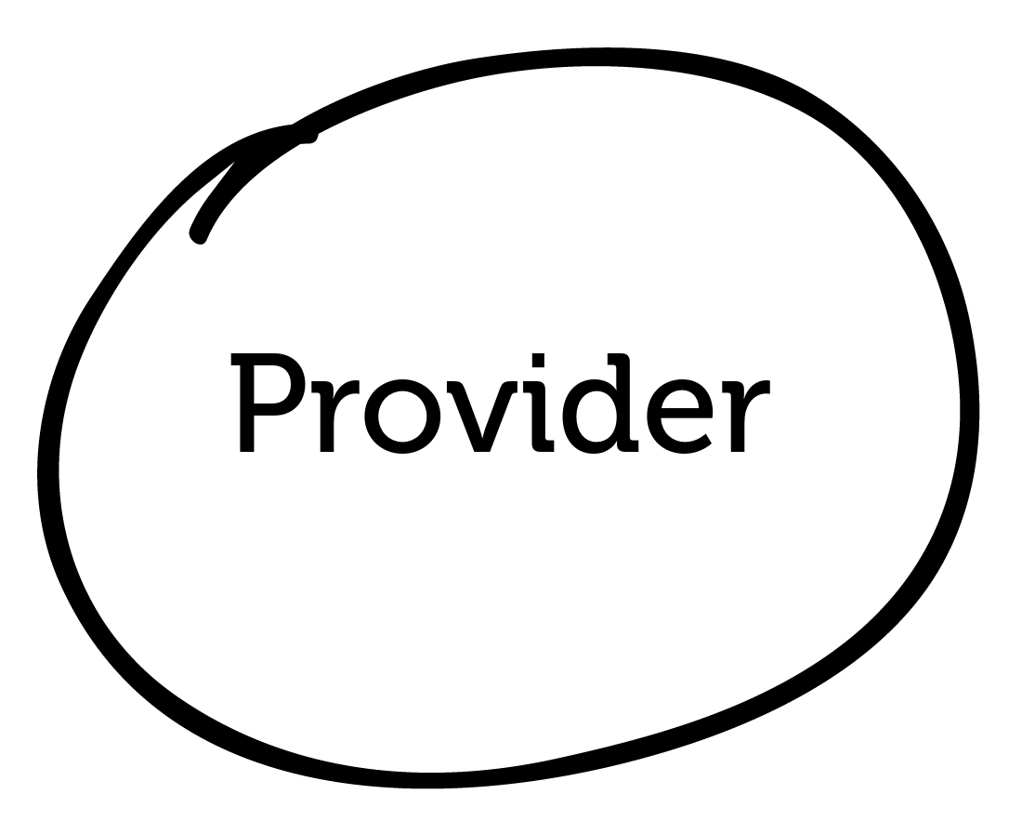
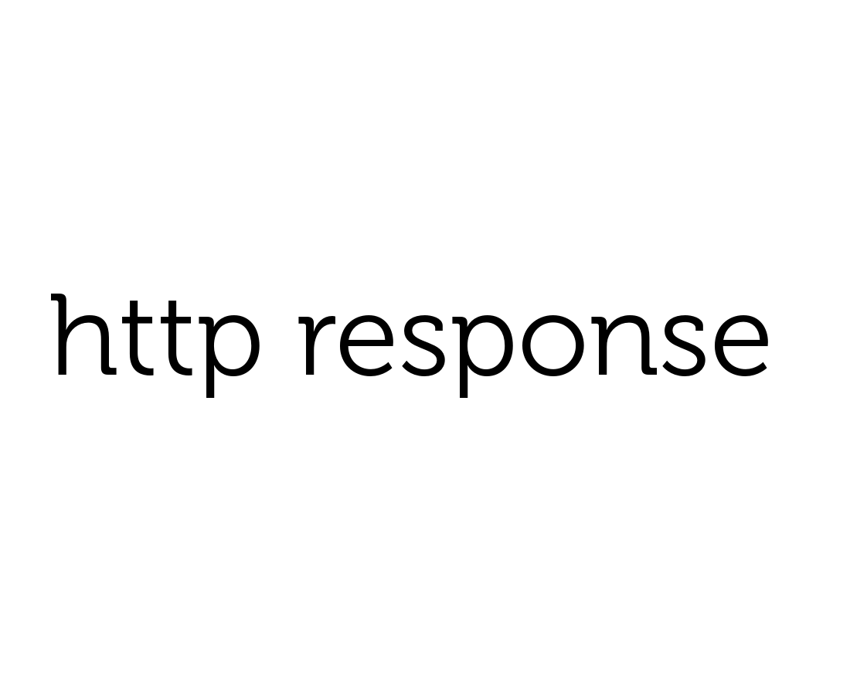
HOW IT WORKS

Slide 37
HOW IT WORKS
Mock

Slide 38
HOW IT WORKS
Mock
GET /orders/1234

Slide 39
HOW IT WORKS
Mock
GET /orders/1234
{
“id”: 1234,
“items”:[
...
],
}

Slide 40


HOW IT WORKS
Mock

Slide 41
HOW IT WORKS
Mock
GET /orders/1234

Slide 42
HOW IT WORKS
Mock
GET /orders/1234
{
“id”: 1234,
“items”:[
...
],
}

Slide 43
HOW IT WORKS
✔︎
Mock

Slide 44
Scope of consumer test
HOW IT WORKS: CONSUMER
Adapters
Services
Domain
External Service
Collaborators
Repositories

Slide 45
Scope of Provider Test
HOW IT WORKS: PROVIDER
Adapters
Services
Domain
mock
Collaborators
Repositories
In-memory database

Slide 46
DEMO
DEMO
Brought to you by

Slide 47
DEMO
Introducing Pactflow
Brought to you by

Slide 48
CHALLENGES WITH PACT
Pact
Sharing and collaborating on pacts between teams
Lifecycle management: managing contracts across code branches and environments
Orchestrating builds to know when it is safe to deploy
Integrating into your processes and tooling

Slide 49
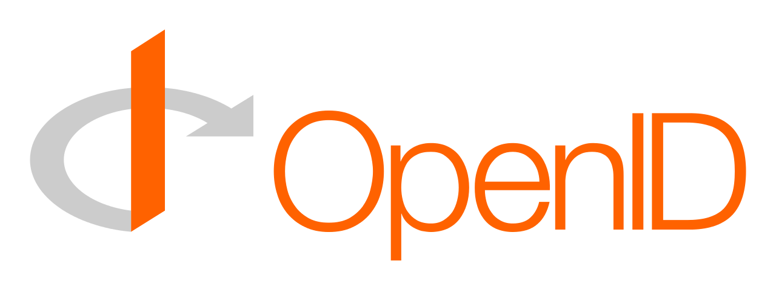






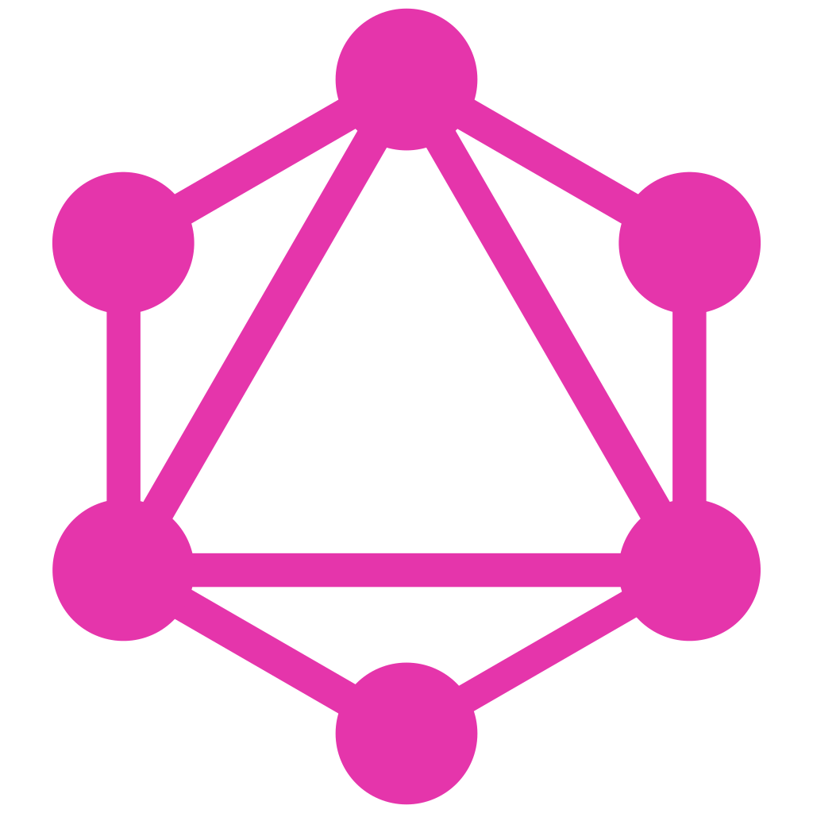
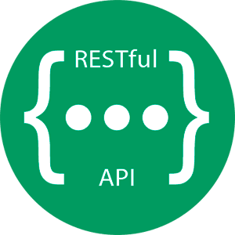

PRODUCT
Pactflow
Contract testing at scale
Additional Capabilities
Fully managed platform + hardened for scale
Better user experience
Secure access management
Collaboration and insights
Expansion to other integration technologies*
* 2020 Roadmap
Security, Identity + Access Management
Collaboration
Tools
Intelligence
Integrations
MQ
Protocols
Broker
Insights
Pact + OSS Tooling

Slide 50
PRODUCT
Integrated collaboration tool to and share and manage pacts* between teams.
API documentation that is guaranteed to be up-to date
Visualisations of the relationships between your services
Dashboards containing contract verification status
Pact tagging and versioning
Webhooks for integration and communication
View pact diffs
...and more!
All powered by a RESTful API

Slide 51
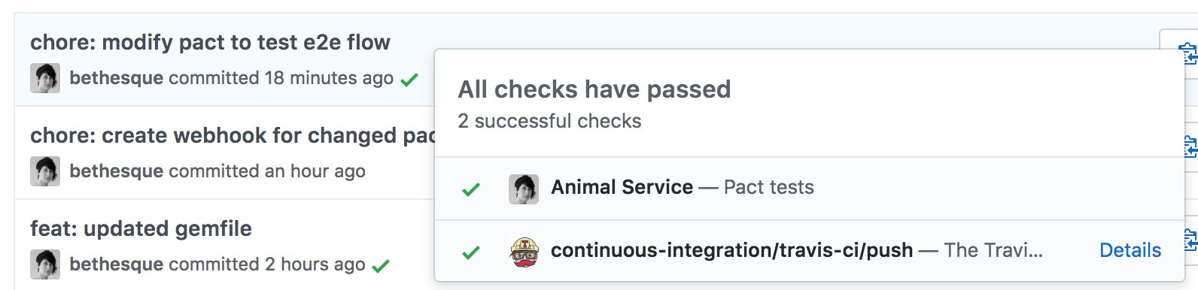
PRODUCT
Did I mention README badges and integrations?

Slide 52
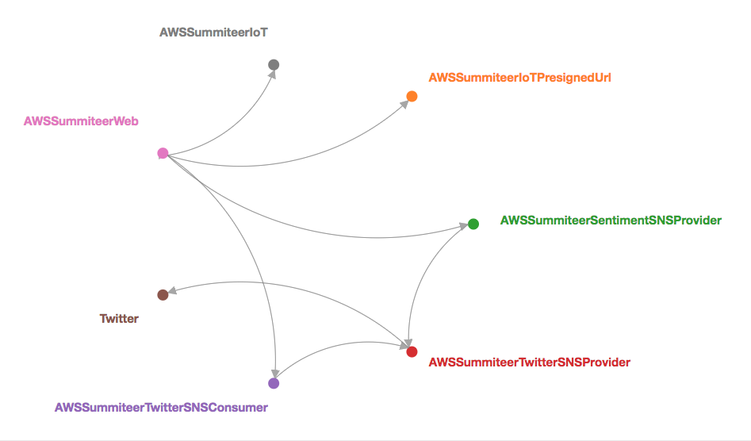
PRODUCT

Slide 53
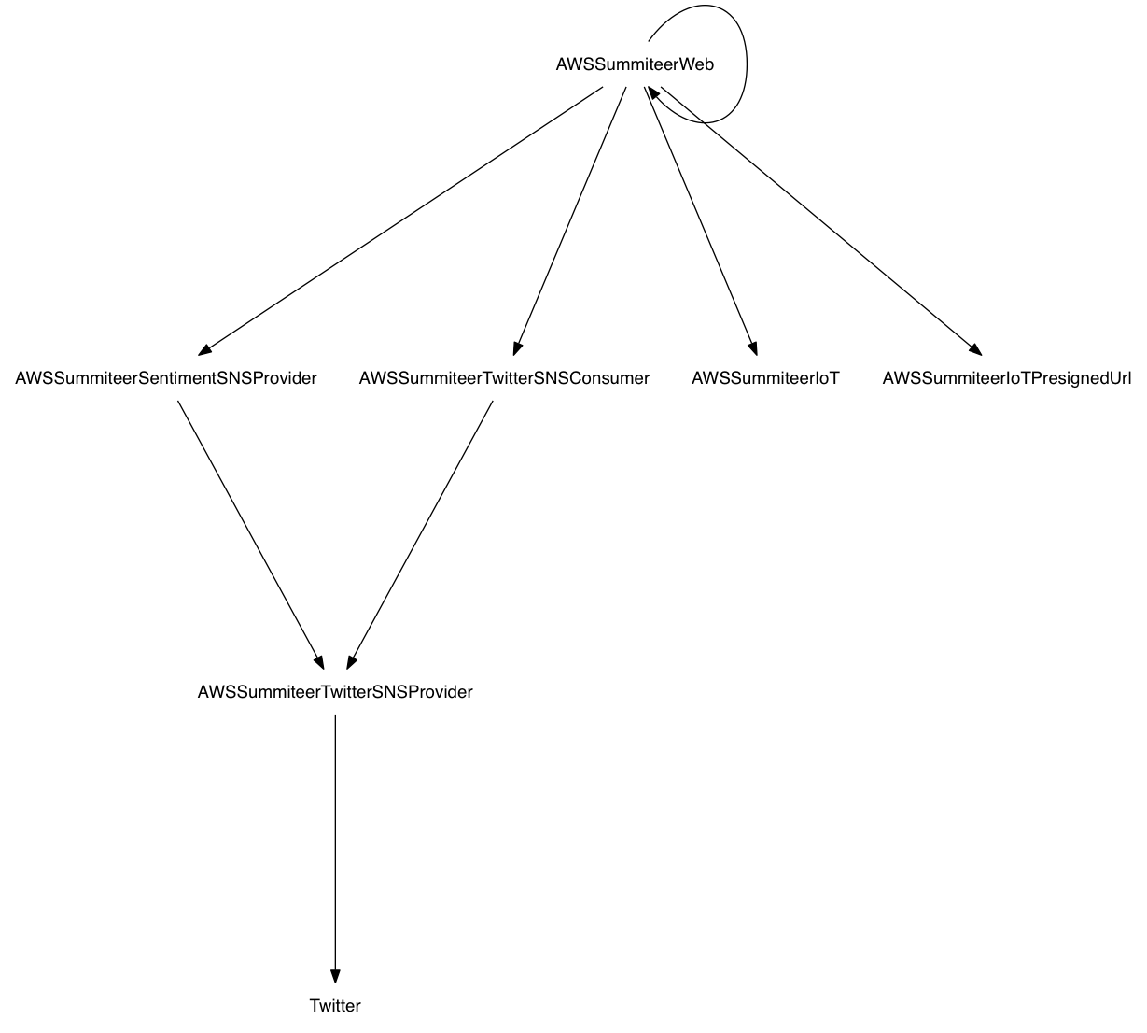
PRODUCT

Slide 54
PRODUCT
Verify that an application is safe to release
Enables “matrix” style testing
 | Consumer Head (1.0.1) | Consumer Prod (1.0.0)
Provider Head (2.0.0) | ? | ?
Provider Prod (1.1.13) | ? | Already tested

Slide 55
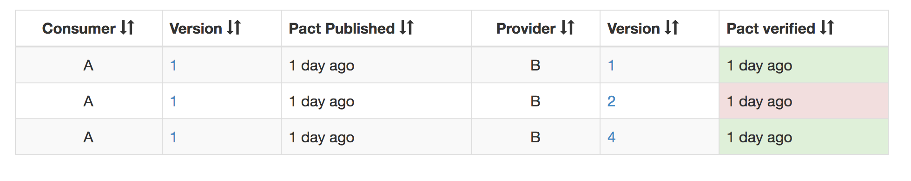
PRODUCT
$ pact-broker can-i-deploy
--app A --version 1
--app B --version 4

Slide 56
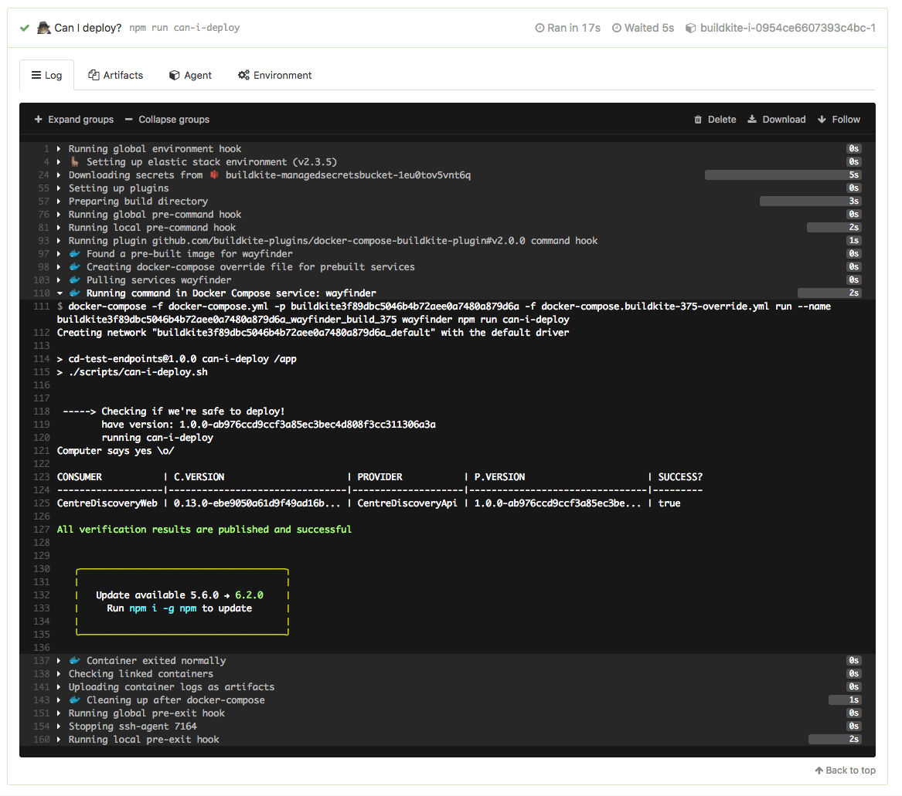
PRODUCT

Slide 57
PRODUCT

Slide 58
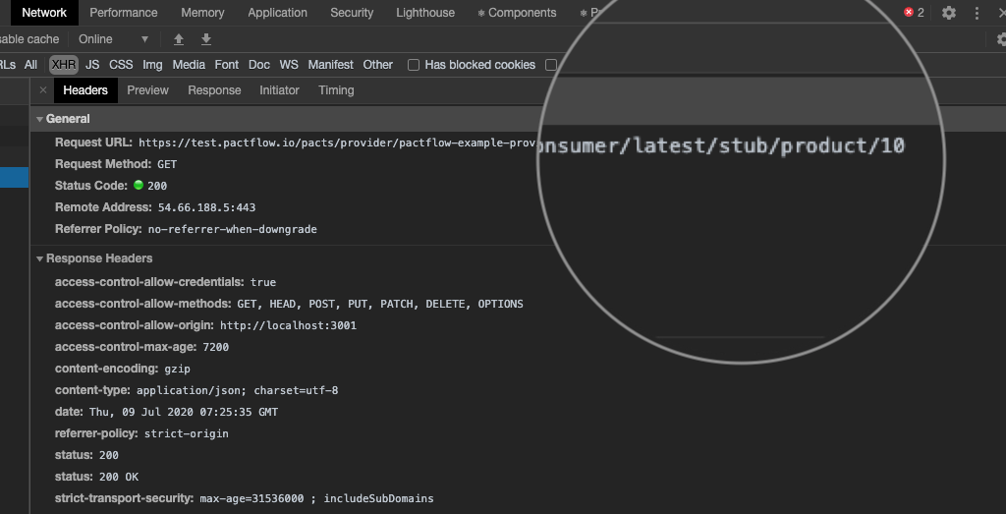
FEATURES
Features
Instant API Stubs
Replace fragile test environments with lightning fast + reliable hosted stubs
Instant API backend for all contracts
Reliable environment for UI e2e tests
Simplify local development against multiple backends
Discover and explore other APIs
Find out more at pactflow.io/blog/hosted-stubs/
Brought to you by

Slide 59
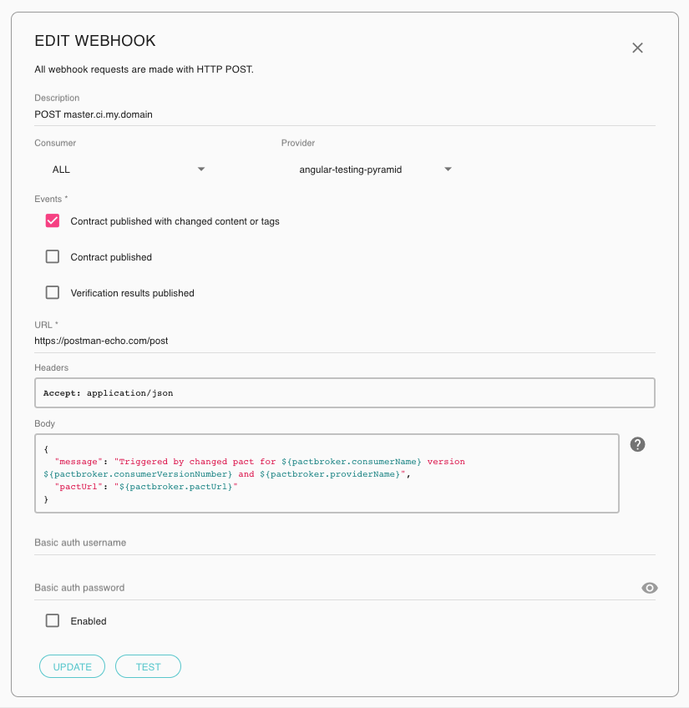
FEATURES
Features
Webhooks
Orchestrate complex build, test and deployment pipelines.
Trigger a build on your CI (such as Travis or Bamboo)
Publish your commit status to GitHub
Notify your teams via Slack of a change to a contract
Find out more at pactflow.io/blog/webhooks/
Brought to you by

Slide 60
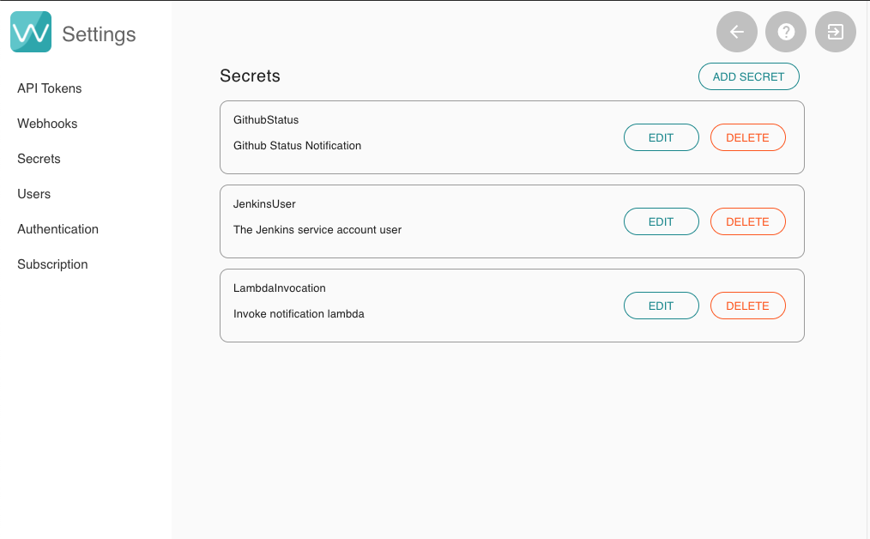
FEATURES
Features
Secrets
Manage sensitive information with our Secrets Management
All secrets are:
Encrypted with customer specific keys
Redacted in all log files
Hidden from all users in the UI
Find out more at pactflow.io/blog/secrets/
Brought to you by

Slide 61
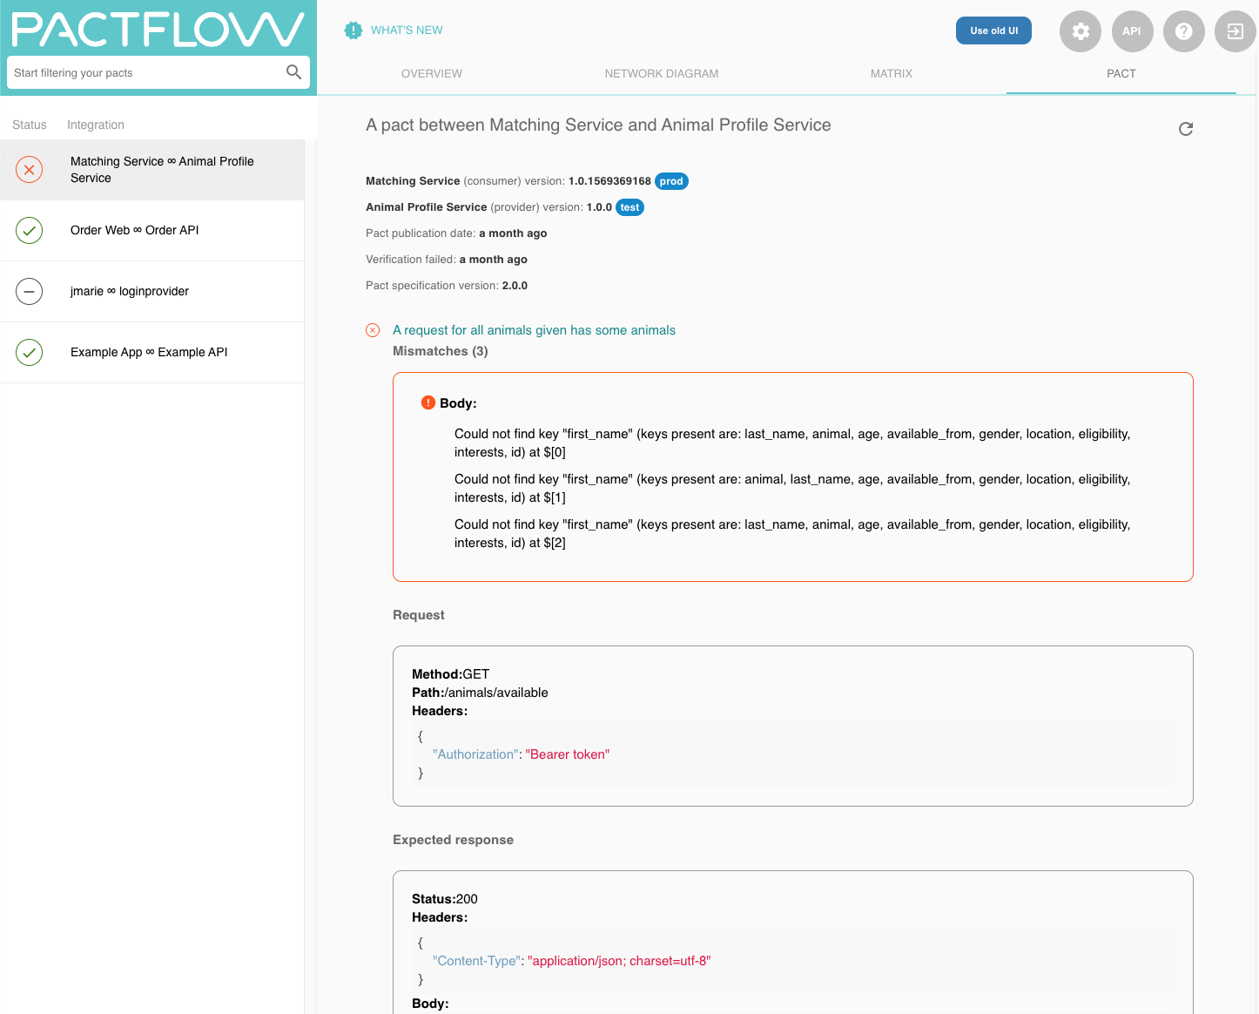
FEATURES
Features
Verification Results
Understand build failures with detailed error reporting via Verifications:
Give visibility to consumer teams and reduce time-to-diagnosis
Breakdown of successful and failed interactions
Understand which field, header or status code was the cause of the problem
Find out more at
pactflow.io/blog/verification-results/
Brought to you by

Slide 62
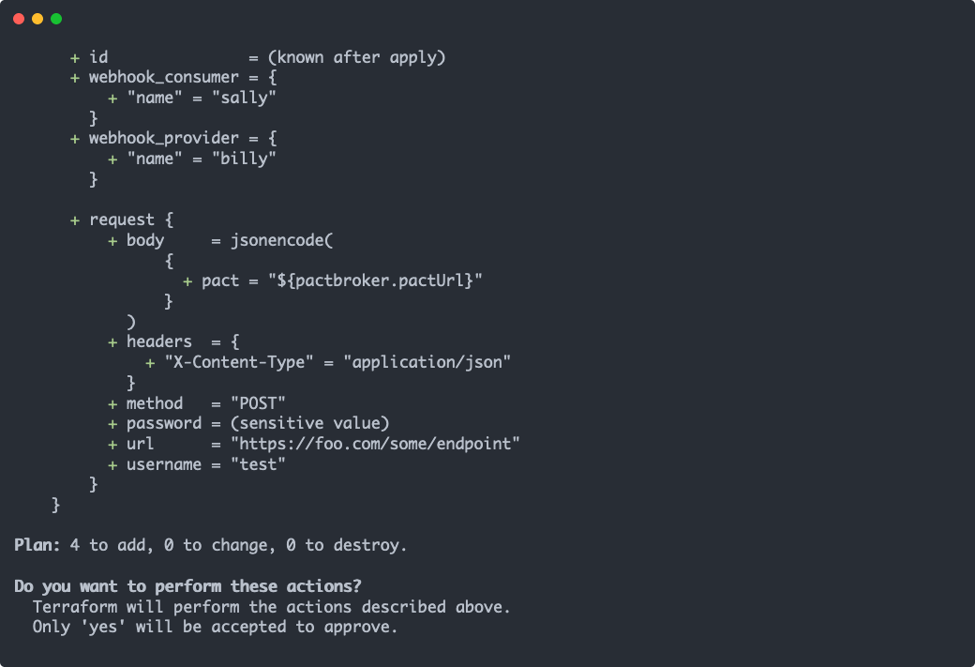
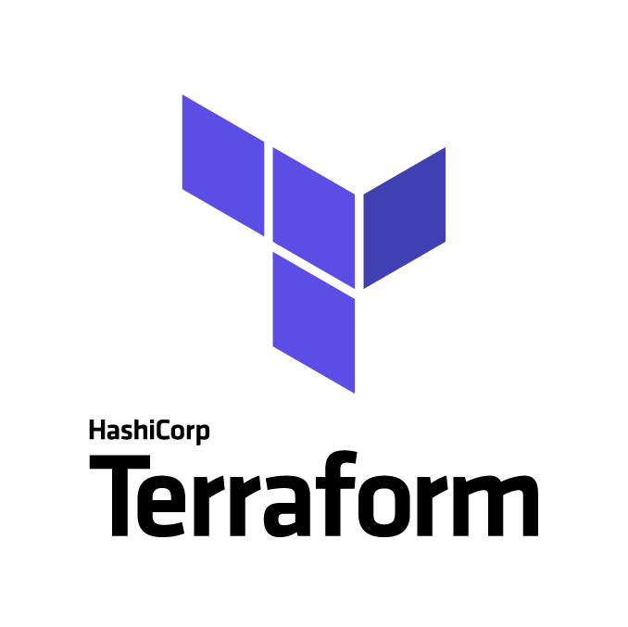
FEATURES
Features
Infra-as-Code
Automate your Pactflow configuration with Terraform:
Pacticipants
Webhooks
Secrets
API Tokens
Find out more at https://pactflow.io/blog/terraform/
Brought to you by

Slide 63
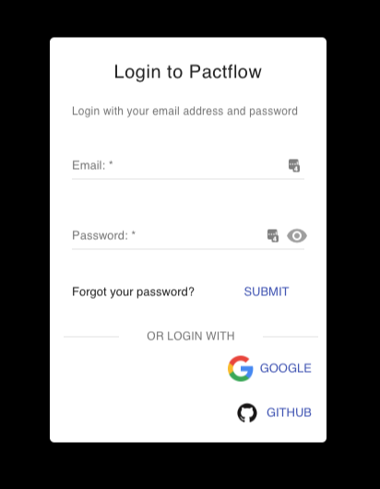
FEATURES
Features
Social Login, SSO and SAML 2.0
Choose how you want to authenticate and manage your users:
Pactflow’s in built user database
Github authentication ¹
Google OpenID connect ¹
SAML ²
Find out more at
pactflow.io/blog/saml-and-federated-authentication/
¹ Available on Team or Business plans
² Available only on Business plans
Brought to you by

Slide 64
FEATURES
Features
Audit Log
{
"events": [
{
"uuid": "16WlpdLpDMzfMYxLTZYXYw",
"timestamp": "2019-12-10T09:15:24.864+11:00",
"type": "SaasBroker::Api::Resources::RegenerateApiToken",
"db_user_id": 2,
"user_email": "someuser@somecompany.com",
"payload": {
"path": "/settings/tokens/_UjhYvyyEjM9L2SgWd0qsw/regenerate",
"queryString": "",
"method": "POST",
"userAgent": "Mozilla/5.0 (Macintosh; Intel Mac OS X 10_14_4) Appl",
"referer": "http://somebroker.pact.dius.com.au/settings/api-tokens",
"params": {
"resource_name": "regenerate_token",
"token_uuid": "_UjhYvyyEjM9L2SgWd0qsw"
}
}
},
...
],
"_links": {
"self": {
"href": "http://somebroker.pact.dius.com.au/audit?from=zHO0xNcjUseyU6DsisadXw"
},
"next": {
"href": "http://somebroker.pact.dius.com.au/audit?from=IlECUSbMLJLOy8gFbLLuIg"
}
}
}
Integrate Pactflow into your SOC:
Immutable audit log available via API
Full traceability of access and system usage, including references to IdP identities
Available to Business Plans
Find out more at
pactflow.io/blog/audit-api/
Brought to you by

Slide 65

PRODUCT
What’s next for Pact?
Modern APIs
Websockets
GraphQL
New Capabilities
Distributed systems are increasingly more complicated, and enterprises need a solution to polyglot integration technologies:
Real-time web apps (Websockets, GraphQL)
Event-based architectures (Kafka/Avro)
High-performance microservices with gRPC and Protobufs
Function-as-a-Service (e.g. lambda)
Legacy SOA apps with SOAP/XML
External APIs
JSON/HTTP
Microservice D
Microservice F
Avro/tcp
Protobufs/gRPC
External API
Microservice E
Microservice G
JSON/HTTP

Slide 66




Team
Email: hello@pactflow.io
Web: pactflow.io
Twitter: @pactflow
Matt Fellows - Founder + JS/Go/Rust Maintainer @matthewfellows
mfellows@dius.com.au
Beth Skurrie - Founder + Ruby Maintainer/Pact Broker Creator
@bethesque
bskurrie@dius.com.au
Ron Holshausen - Founder + Pact JVM/Rust Maintainer @uglyog
rholshausen@dius.com.au
Brought to you by

